Slide 1
NSSE PWPT Template: Notes to Users
This sample presentation is designed to serve as a customizable template to present NSSE, BCSSE, or FSSE results on your campus. The presentation is divided into the following topical sections to help you quickly select the slides most appropriate for a particular audience:
    NSSE and the Concept of Student Engagement
    Selected NSSE Results for [Institution]
    Selected BCSSE Results for [Institution]
    Selected FSSE Results for [Institution]
    User Resources and Activities of the NSSE Institute
    Using Your NSSE, BCSSE, and FSSE Data
    Questions & Discussion
    Contact Information
Replace the cover slide, images, and the red text throughout this presentation with the name of your school and your own results.
Use slides from the “Selected Results for [Institution]” sections for ideas on how to present your campus results.
View the notes section of each slide for additional information or relevant talking points (in the PowerPoint tool bar select “VIEW” then “Notes Page”)
Notes:
Check this notes section throughout the presentation for suggestions on how to utilize slides and additional information that can serve as background information or “talking points” during your presentation.
To view this notes section of the presentation, select the “View” tab, then the “Notes Page” option.
NSSE recommends adding your own notes and talking points to this section, then print off a notes version for use during your presentation. To do so, select “File,” then “Print,” then change settings to: “Notes Pages.”

Slide 2


Presentation title slide
Author Name, Title
Author Name, Title

Slide 3
Presentation Overview
The Concept of Student Engagement
Selected NSSE Results for [Institution]
Selected BCSSE Results for [Institution]
Selected FSSE Results for [Institution]
User Resources
Using Your NSSE, BCSSE, and FSSE Data
Questions & Discussion
Contact Information
Notes:
Adapt this slide to fit the outline of your presentation.

Slide 4

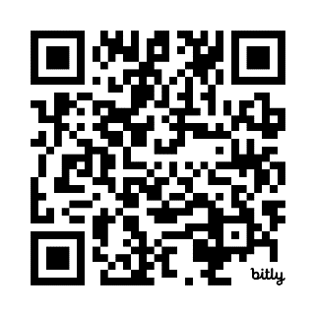
What is Student Engagement?
PART 1: The amount of time and effort students put into their studies and other educationally purposeful activities
PART 2: How institutions deploy resources and organize curriculum & other opportunities to increase student participation in activities linked to learning
Scan to view Student Engagement Primer
Notes:
4
Development of Concept of Student Engagement
C. Robert Pace (1970s)
Pioneer of looking at the entire student experience versus just looking at test scores or grades to assess student learning.
Explored students’ academic and social experiences in college – and assessed the quality of effort students put forth in their educational experiences
Alexander Astin (Hired by Pace at UCLA in 1980s)
Promoted theory of student involvement
Amount of learning taking place directly proportional to quantity and quality of energy invested in educational activities
Vincent Tinto (Also in the 1980s)
Retention model – focus on greater social and academic integration, both formal and informal processes -> greater satisfaction -> more likely to stay
Ernest Pascarella & Patrick Terenzini
Examined impact of college experience.
Arthur Chickering and Gamson (1980s analysis of hundreds of studies over several decades)
Good practice in undergraduate education includes: 1) Student-faculty contact, 2) Cooperation among students, 3) Active learning, 4) Prompt feedback, 5) Time on task, 6) High expectations, 7) Respect for diverse talents and ways of learning
George Kuh (1990s – idea of student engagement)
What students do -- time and energy devoted to educationally purposeful activities
What institutions do -- using effective educational practices to induce students to do the right things

Slide 5

Seven Principles of Good Practice in
Undergraduate Education
Student-faculty contact
Active learning
Prompt feedback
Time on task
High expectations
Experiences with diversity
Cooperation among students
Chickering, A. W. & Gamson, Z. F. (1987). Seven principles for good practice in undergraduate education. AAHE: Bulletin, 39 (7), 3-7;
Siering, G. (2020). Applying Chickering’s 7 Principles to Remote Learning https://blogs.iu.edu/citl/2020/09/16/seven-principles/
Notes:
5

Slide 6




Suggested Readings
McCormick, A. C., Kinzie, J., & Gonyea, R. M. (2013). Student engagement: Bridging research and practice to improve the quality of undergraduate education. In M. B. Paulsen (Ed.), Higher education: Handbook of theory and research (pp 47-92), Vol. 28. Springer Netherlands.
Pascarella, E. & Terenzini, P (2005). How college affects students: A third decade of research. San Francisco: Jossey-Bass Publishers.
Mayhew, M. et al., (2016). How college affects students: 21st century evidence that higher education works. San Francisco: Jossey-Bass Publishers.
Kuh, G. D., Kinzie, J., Schuh, J. H., Whitt, E.J., & Associates (2005/2010). Student success in college: Creating conditions that matter. San Francisco: Jossey-Bass.
Notes:
6

Slide 7
NSSE Background
Launched with grant from The Pew Charitable Trusts in 1999, supported by institutional participation fees since 2002.
Institution types, sizes, and locations represented in NSSE are largely representative of U.S. baccalaureate institutions.
Nearly 1700 baccalaureate-granting colleges and universities in the US and Canada have participated to date.
Year​ | Institutions​
2018​ | 505​
2019​ | 531​
2020​ | 601​
2021​ | 356​
2022​ | 456​
2023 | 541
2024 | 372
Notes:
How and why was the NSSE survey developed?
NSSE was specifically designed to assess the extent to which students are engaged in empirically derived effective educational practices and what they gain from their college experiences. Voluminous research on college student development shows that the time and energy students devote to educationally purposeful activities is the single best predictor of their learning and personal development. Therefore, the main content of the NSSE instrument represents student behaviors that are highly correlated with many desirable learning and personal development outcomes of college.
The original Design Team, convened by The Pew Charitable Trusts in 1988, consisted of Alexander Astin, Gary Barnes, Arthur Chickering, Peter Ewell, John Gardner, George Kuh, Richard Light, and Ted Marchese with input from C. Robert Pace to help draft a survey instrument.

Slide 8

Goals of NSSE Project
Focus conversations on undergraduate quality
Enhance institutional practice and improvement initiatives
Foster comparative and consortium activity
Provide systematic national data on “effective educational practices”

Slide 9
NSSE Survey Content
Student Learning & Development
Engagement in meaningful academic experiences
Engagement in High-Impact Practices
Student reactions to college
Student background information

Slide 10
NSSE Engagement Indicators
Engagement Themes
Engagement Indicators
Academic Challenge
Learning with Peers
Experiences with Faculty
Campus Environment
Higher-order Learning
Reflective & Integrative Learning
Collaborative Learning
Discussions with Diverse Others
Student-Faculty Interaction
Effective Teaching Practices
Quality of Interactions
Supportive Environment
Learning Strategies
Quantitative Reasoning
Student – Faculty Interaction
Notes:
10

Slide 11
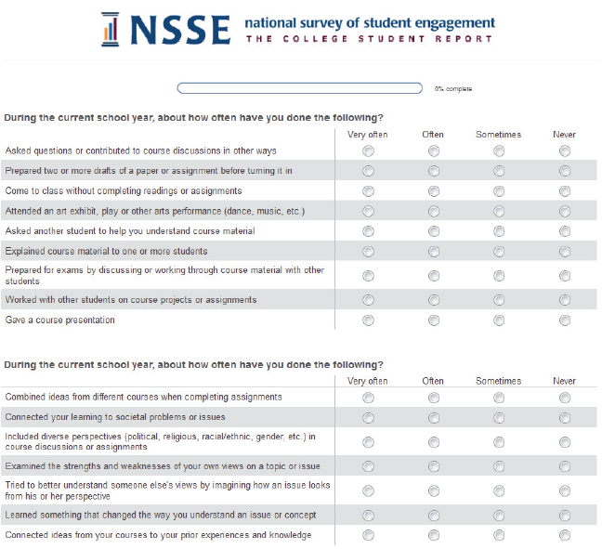

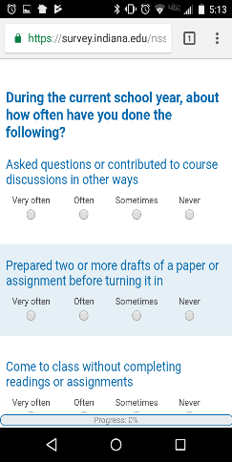
Survey Administration
Census-administered or randomly sampled first-year students & seniors
Mobile-optimized survey
Spring administration
Multiple follow-ups to increase response rates
Topical Modules provide
option to delve deeper into
the student experience
Consortium participation enables addition of custom questions

Slide 12
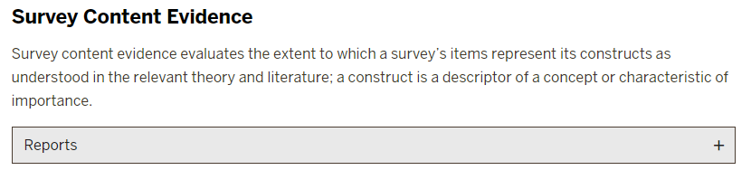
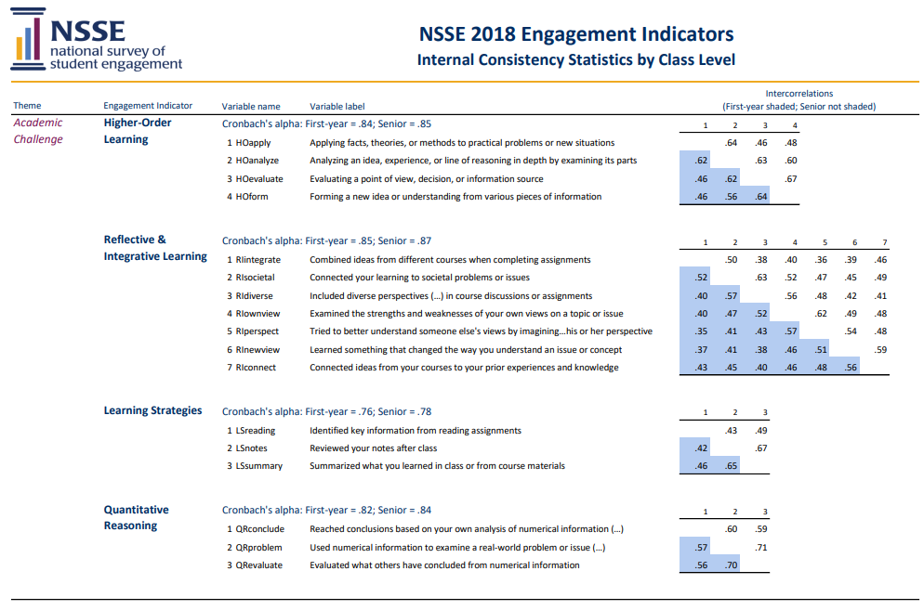
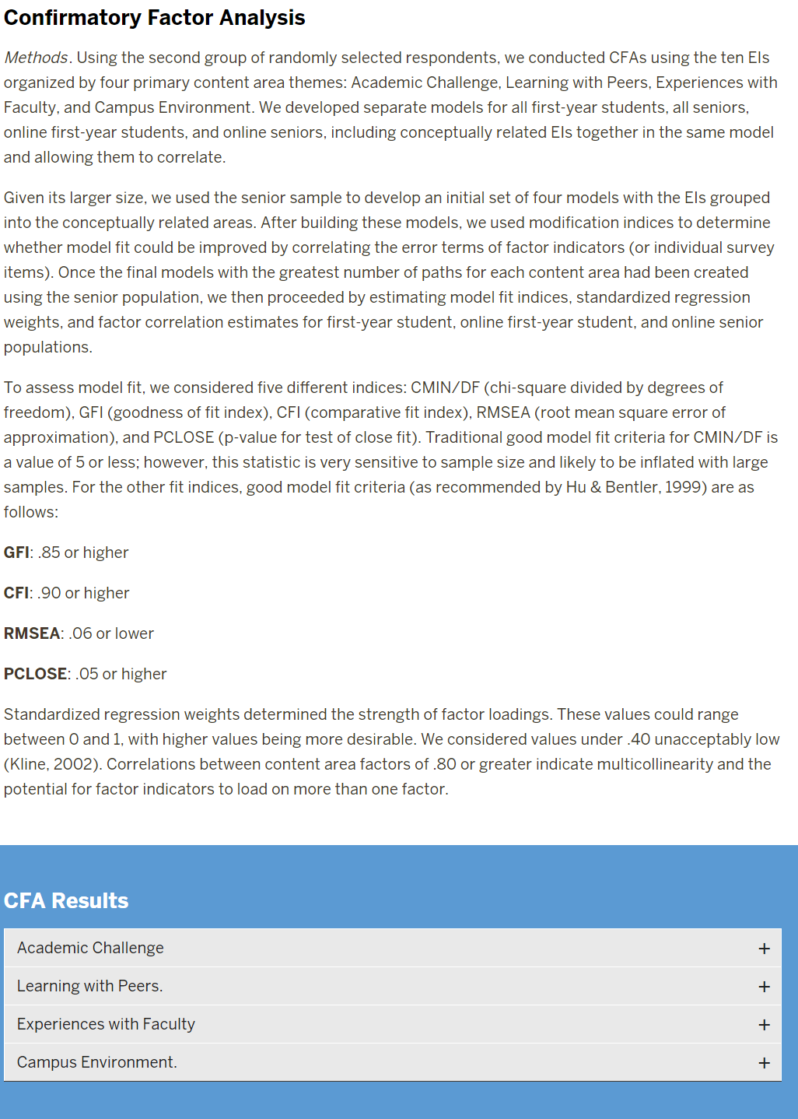
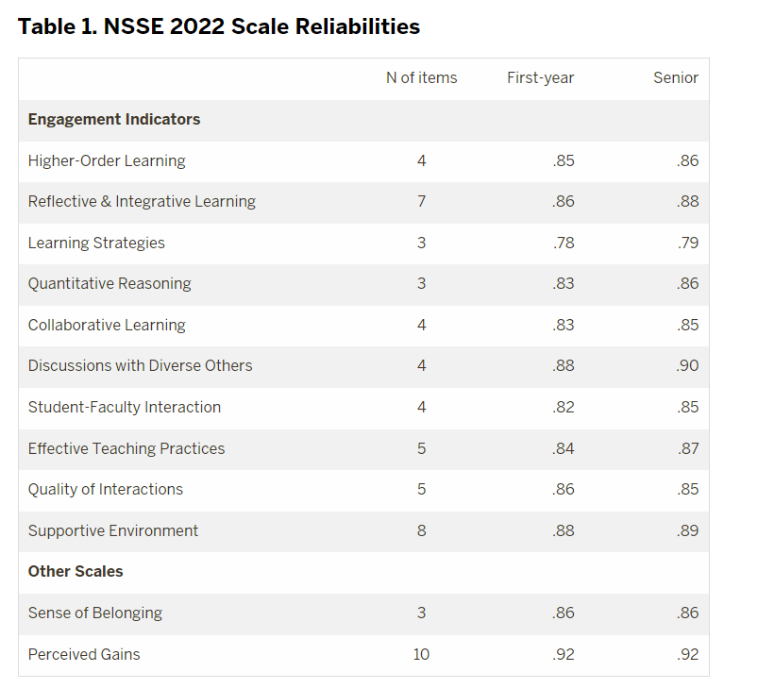
Psychometric Portfolio
NSSE’s Psychometric Portfolio presents evidence of validity, reliability, and other indicators of data quality. It serves higher education leaders,
researchers, and professionals who use NSSE.
Click here to view the psychometric portfolio
Notes:
Images here are decorative- not meant to be read for interpretation on screen

Slide 13
Selected nsse results for [institution]

Slide 14

NSSE 2024 Administration Overview
Much has changed in
the higher education
landscape over the past
few years
A shift to more flexible learning options since 2020 and 2021
Interest in assessing student engagement is robust, with institutions using data to understand the student experience as we continue to navigate a new normal and aim to be more response to college student needs

Slide 15

NSSE 2024 Administration Overview (cont’d)
In 2024 NSSE made updates to gender-identity items, including a “select all that apply” option, and modified end-of-survey prompts to include institutionally customizable questions.
Given increased email security systems on most campuses, NSSE partnered with an email delivery expert, Mxtoolbox, to monitor blocklists, and facilitate email delivery, and refined early warning dashboards to detect delivery issues.
Institutions were permitted to send recruitment emails and text messages on their own.
Notes:
This is a general picture of the NSSE administration. Institutions may want to describe their student invitation process.

Slide 16
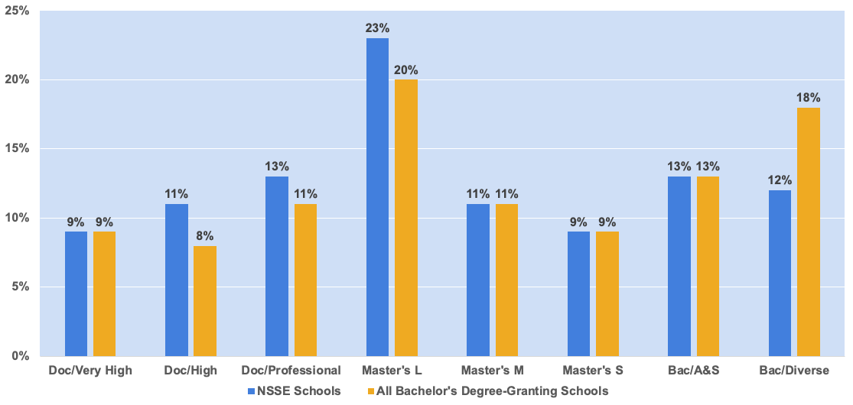
NSSE 2024 Institutions by Carnegie Classification
Notes:
NSSE [year] participating institutions and students reflect the diversity of bachelor’s-granting colleges and universities in the US with respect to institution type, public or private control, size, region, and locale. A searchable list of participating institutions is on the NSSE website: nsse.indiana.edu/support-resources/participating-institutions/index.html

Slide 17
NSSE 2024 Percentage Respondents by Race, Ethnicity, and Nationality
Race/Ethnicity | NSSE [year] Respondents | U.S. Bachelor’s-Granting Population
African American/Black | 10 | 12
American Indian/Alaska Native | <1 | <1
Asian | 7 | 8
Native Hawaiian/other Pacific Islander | <1 | <1
Caucasian/White | 55 | 52
Hispanic/Latino/Latine | 19 | 19
Multiracial/multiethnic | 5 | 4
Foreign/nonresident alien | 4 | 4
Notes:
Note: Percentages are unweighted and may not sum to 100 due to rounding. Institution-reported, using categories provided in IPEDS. NSSE percentages do not include students with unknown race/ethnicity. The NSSE [year] sampling frame consists of first-year and senior undergraduates. Data were provided by participating institutions. U.S. percentages are based on data from the 2021 IPEDS Institutional Characteristics and Enrollment data. Includes all class years.

Slide 18
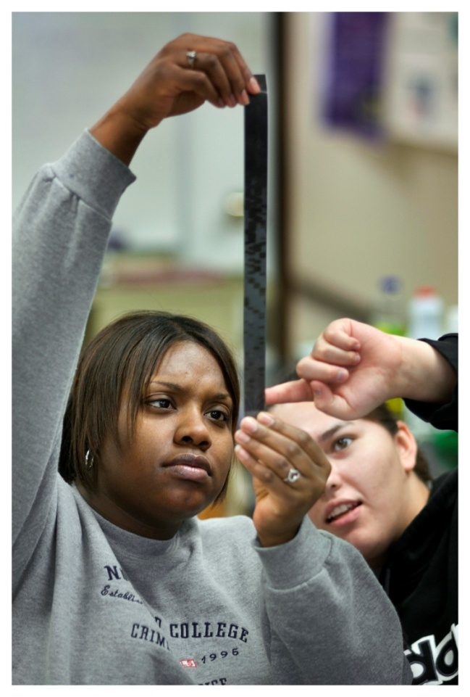
NSSE 2024 Survey
Population and Respondents
Approximately 1 million students from 373 institutions were invited to participate in NSSE 2024, with 187,229 responding.

Slide 19
NSSE 2024 U.S. Institution
Response Rates
[Your institution’s] response rate = x%
All US NSSE 2024 institutions = 23%
NSSE
U.S. Average
Institutional
Response Rates
by Enrollment:
Undergraduate Enrollment | NSSE 2024 | NSSE 2023
2,500 or fewer | 28 | 32
2,501 to 4,999 | 22 | 25
5,000 to 9,999 | 20 | 20
10,000 or more | 16 | 19
All institutions | 23 | 26
Notes:
The average response rate for U.S. NSSE [year] was 26% (down from 28% in 2022).

Slide 20
NSSE [year] Results (Sample Slides)
The following slides are examples of how your institution might share selected NSSE results with various institutional constituencies. Expand this section to highlight items of interest to your audience.
Notes:
20

Slide 21
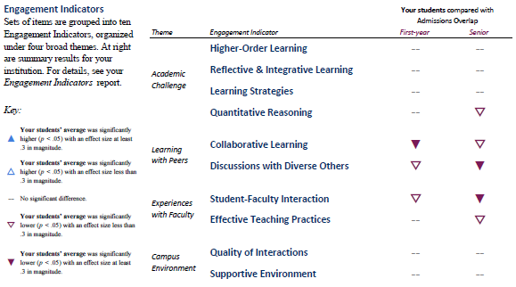
Overall results compared to peer group for each Engagement Indicator
Notes:
This is a “snip” from the Snapshot. You can copy and paste this image from your snapshot directly into this slide for presentation.
Engagement Indicators: Sets of items are grouped into ten Engagement Indicators, which fit within four themes of engagement. At right are summary results for your institution. For details, see your Engagement Indicators report.

Slide 22
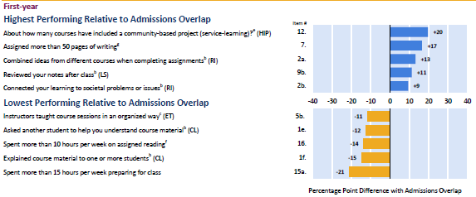
Highest and lowest performing items compared to peer group (FY)
Notes:
This is a “snip” from the Snapshot. You can copy and paste images from your Snapshot directly into this slide for presentation. This slide is showing the highest and lowest performing items for first-year students at [Institution] compared to the peer group that was selected for use in the Snapshot.

Slide 23
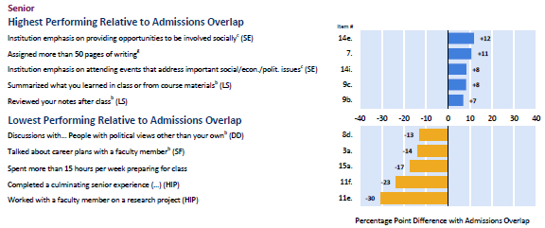
Highest and lowest performing items compared to peer group (SR)
Notes:
This is a “snip” from the Snapshot. You can copy and paste images from your Snapshot directly into this slide for presentation. This slide is showing the highest and lowest performing items for seniors at [Institution] compared to the peer group that was selected for use in the Snapshot.

Slide 24
Engagement Indicator: Quality of Interactions
  Indicate the quality of your interactions with the following people at your institution. (First-year students)
Notes:
These numbers for your institution can be found in the NSSE [year] Frequencies and Statistical Comparisons.
To modify this chart, double click on the chart, select the “sheet 1” tab and insert your data, then select the “chart” tab.

Slide 25
Engagement Indicator: Discussions with Diverse Others
  How often have you had discussions with people from the following groups? (First-year students)
Notes:
These numbers for your institution can be found in the NSSE [year] Frequencies and Statistical Comparisons.
To modify this chart, double click on the chart, select the “sheet 1” tab and insert your data, then select the “chart” tab.

Slide 26
High‐Impact Practices (FY)
  Percentage of first-year students who participated in a learning community and in course-based service-learning.
Notes:
These numbers for your institution can be found in the NSSE [year] Frequencies and Statistical Comparisons.
To modify this chart, double click on the chart, select the “sheet 1” tab and insert your data, then select the “chart” tab.

Slide 27
Engagement Indicators: LS and CL (First-Year Students)
  Learning Strategies and Collaborative Learning
  (First-Year Students)
Notes:
These numbers for your institution can be found in the NSSE [year] Engagement Indicators.
To modify this chart, double click on the chart, select the “sheet 1” tab and insert your data, then select the “chart” tab.

Slide 28
High‐Impact Practices (SR)
  Percentage of seniors who worked on a research project with a faculty member, and who did a culminating senior experience.
Notes:
These numbers for your institution can be found in the NSSE [year] Frequencies and Statistical Comparisons.
To modify this chart, double click on the chart, select the “sheet 1” tab and insert your data, then select the “chart” tab.

Slide 29
Engagement Indicators: HO and SF (Seniors)
  Higher-Order Learning and Student-Faculty Interaction (Seniors)
Notes:
These numbers for your institution can be found in the NSSE [year] Engagement Indicators.
To modify this chart, double click on the chart, select the “sheet 1” tab and insert your data, then select the “chart” tab.

Slide 30
How do students spend their time?
Preparing for Class
  Percentage spending more than 10 hours per week preparing for class
Class | [Institution] | Selected Peers
First-Year | More than x% | More than x%
Senior | More than x% | More than x%
Notes:
These numbers for your institution can be found in the NSSE [year] Frequencies and Statistical Comparisons.

Slide 31
How do students spend their time?
Co-Curricular Activities
  Percentage of students spending more than 5 hours per week participating in co-curricular activities
Class | [Institution] | Selected Peers
First-Year | More than x% | More than x%
Senior | More than x% | More than x%
Notes:
While college is organized around formal learning venues (classrooms, laboratories, studios), it is clear from the many desired outcomes associated with out-of-class experiences that engaging students in more educationally purposeful activities outside the classroom would be valuable. Students of all backgrounds seem to benefit from such experiences.

Slide 32

Selected BCSSE results for [institution]

Slide 33

BCSSE Purpose
BCSSE has common content for all students regarding their academic expectations and perceptions for the coming year.
There are also BCSSE questions specific to first-year, transfer, and older students. These targeted questions provide a more in-depth understanding of each of these unique groups of students.

Slide 34

BCSSE Survey Content
There are three sections to the BCSSE survey:
  Prior educational
  experiences
  Expectations and
  beliefs regarding the
  upcoming college year
  Background
  characteristics

Slide 35

Administration Modes
Paper, Web, or Mixed Modes
  Paper group administration
  (FY only)
    Orientation, Welcome
    Week, etc.
  Web group administration
    While students are in computer lab, etc.
  Web email administration
    Web link emailed to
    students

Slide 36
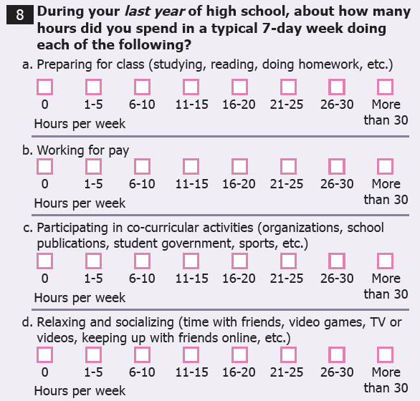
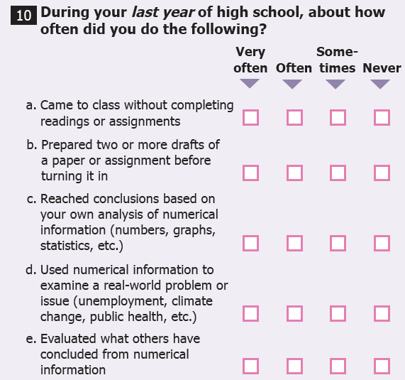
BCSSE: Prior Educational Experiences

Slide 37
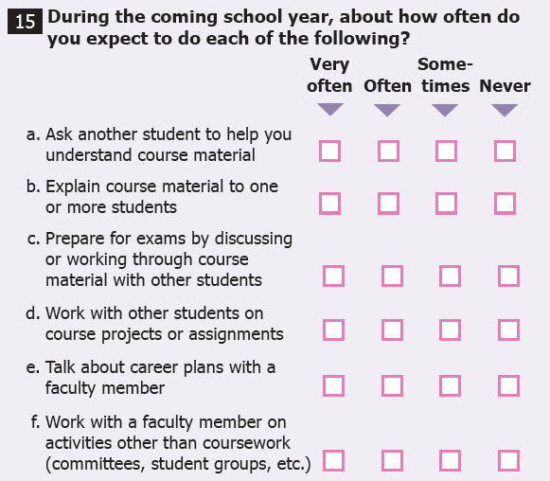
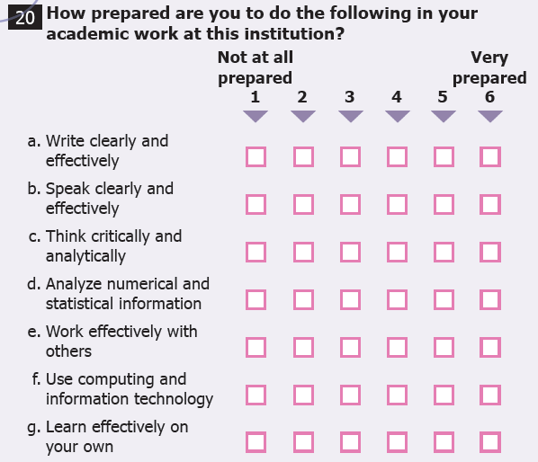
BCSSE: Expectations for the First Year of College

Slide 38
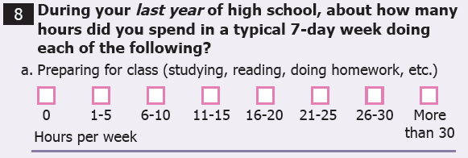
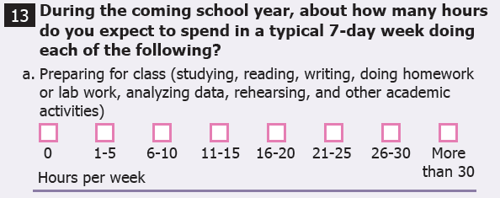
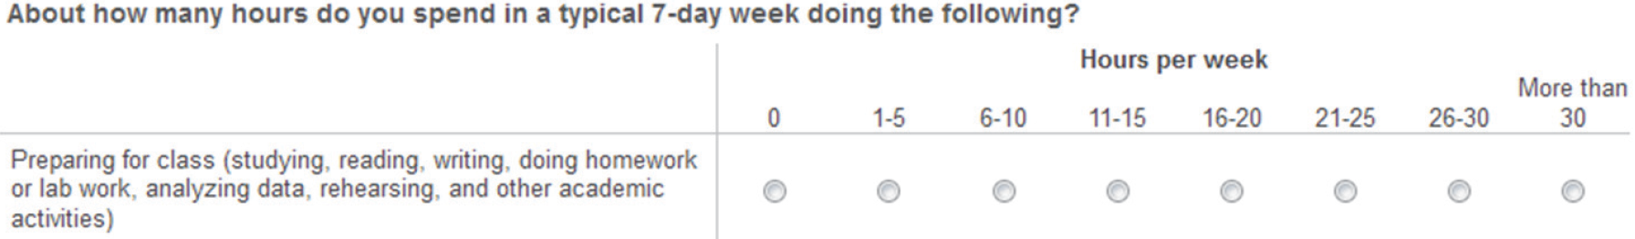
BCSSE-NSSE
Many of these questions are designed to be paired
with NSSE, providing an in-depth view of the
first-year experience.
BCSSE
NSSE

Slide 39
BCSSE Scales
BCSSE Scales | Corresponding NSSE Engagement Indicator
High School Quantitative Reasoning | ü
High School Learning Strategies | ü
Transfer Student Learning Strategies (Transfer student only) | ü
Expected Student-Faculty Interactions | ü
Expected Collaborative Learning | ü
Expected Discussions with Diverse Others | ü
Importance of Campus Environment | ü
Expected Academic Perseverance | *
Expected Academic Difficulty | *
Expected Academic Help-Seeking | *
Perceived Academic Preparation | * *
* Items in these three BCSSE scales also correspond to NSSE’s First-Year Experience Module
** Items in this BCSSE scale also correspond to NSSE’s personal gains items

Slide 40
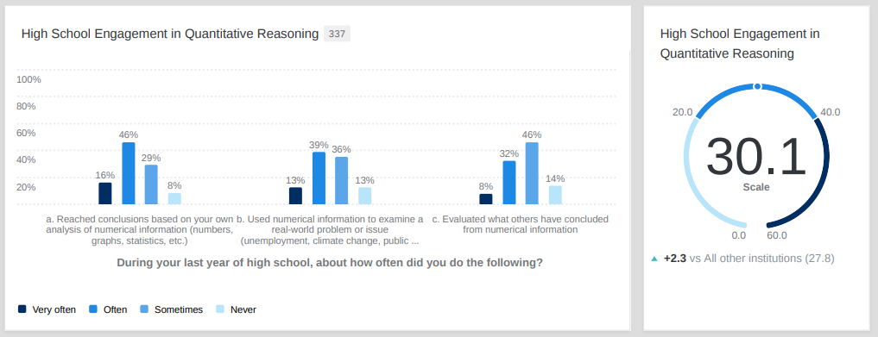
BCSSE Reports
A word about BCSSE’s enhanced reports:
I love the dashboards. These have been the most useful in-the-moment visualizations.
  --Laura Monje-Paulson, Ph.D., Assistant Vice President for Student Affairs, Sonoma State University
Four reports are provided, all via online dashboards:
  BCSSE Institutional Report
  (Summer/Fall 2023)
  BCSSE Student Advising Report (Summer/Fall 2023)
  BCSSE23-NSSE24 Combined Report

Slide 41
Concerns about mental and emotional health
  During the coming school year, how concerned are you about the following?
Notes:
One way to present your data is to examine responses to individual items from the BCSSE 2023 Online Dashboards.
To modify this chart, double click on the chart, click on “Edit Data” above and insert your data, then close the Excel sheet.

Slide 42
During the coming school year, how difficult do you expect the following to be?
  Learning course material
Notes:
One way to present your data is to examine responses to individual items by groups of students relevant to your campus (e.g., first-generation status) from the BCSSE 2023 Online Dashboards.
To modify this chart, double click on the chart, click on “Edit Data” above and insert your data, then close the Excel sheet.

Slide 43
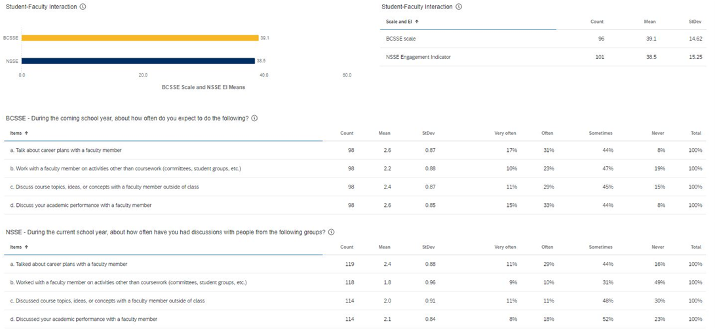
BCSSE 2023-NSSE 2024 Combined Results for [Institution]
Student-Faculty Interaction BCSSE and NSSE Results
Notes:
You can show the BCSSE-NSSE results live from the dashboard for presentations or download the data from your dashboard to add new slides to the PowerPoint

Slide 44
Selected FSSE Results for [Institution]

Slide 45

Selected FSSE results for [institution]

Slide 46

Faculty Survey of Student Engagement
(FSSE is pronounced “fessie”)
College faculty survey that measures faculty expectations for student engagement in educational practices that are empirically linked with student learning and development

Slide 47

FSSE Survey Content
How often faculty use effective teaching practices
How much faculty encourage students to collaborate
The nature and frequency of faculty-student interactions
Opportunities to engage in diverse perspectives
The importance faculty place on increasing institutional support for students
The importance faculty place on various areas of learning and development
How faculty members organize their time, both in and out of the classroom

Slide 48

FSSE 2024 Project Scope
In 2024, more than 5,200 faculty members from 54 institutions responded to the survey.
In 2024, 20% of the faculty contacted responded to the survey.
Response rates at individual institutions ranged from 6% to 52%.
The average institutional response rate was 24%.

Slide 49
FSSE Administration
Third-party administration in the spring
Institutions choose faculty to be surveyed
Faculty responses are kept anonymous to the institution
Administered as an online-only survey
Institutions can add topical modules and consortium items to the end of the core FSSE instrument

Slide 50
NSSE’s Ultimate Goal
NSSE’s ultimate goal is not to collect and report data but to help catalyze
institutions’ data use for improvement in undergraduate education.

Slide 51
User Resources and the
NSSE Institute
The NSSE Institute for Effective Educational Practice develops user resources and responds to requests for assistance in using student engagement results to improve student learning and institutional effectiveness.
    Free Webinars
    Accreditation Toolkits
    Guides to Data Use
    Lessons from the Field
    NSSE Item Campuswide Mapping
    A Pocket Guide to Choosing a College
    Tips for More Inclusive Data Sharing and Analysis
    A NSSE Data User's Guide: Sense of Belonging
  Visit The NSSE Data and Results Guide Here

Slide 52



A Pocket Guide to Choosing a College
For Students and Families:
  A Pocket Guide to Choosing a College gives questions to ask during a campus visit about what matters to learning.
For NSSE Institutions:
  A data report, NSSE [year] Answers
  from Students provides results for admissions, orientation, prospective students and families, and
  campus Web sites.
    * Available in Spanish, and in a mobile version.
Notes:
You can order/request copies of the Pocket Guide at nsse.indiana.edu/links/pocket

Slide 53



Using Your NSSE, BCSSE, and FSSE Data

Slide 54
Using NSSE, BCSSE, and FSSE Data
Areas of
Effective
Educational
Practice
It is important for NSSE to document and share ways student engagement results are used.
NSSE results are used across all types of institutions.
The following slides illustrate how NSSE data inform educational policy and practice at specific institutions.
Areas for
Institutional
Improvement
Notes:
NSSE recommends creating your own slides and action items for your college or university.

Slide 55
Internal Campus Uses
Share results to encourage dialogue about effective practice
Explore differences in student
engagement between
first-years and seniors
Connect data to campus
concerns
Assess change over time
Link with other data
to test hypotheses,
evaluate programs
Use data to make the case for
change in curricula,
instruction, services
Learning
Communities
Enrollment
Management
1ST-Year
and Senior
Experience
Institutional
Research
Academic
Affairs
Institutional
Improvement
Student
Affairs
Learning
Assessment
Peer
Comparison
Faculty
Development
Academic
Advising
Notes:
Institutions often use several approaches to share their results. It is usually most effective to use a combination of dissemination techniques.
Targeting specific audiences to share results can facilitate focused dialogue about implications of the findings for policy and practice. For example:
Present findings to a faculty advisory committee
Plan a half day retreat for student affairs staff
Institutions can share results campus-wide by posting summaries of important findings or by inviting colleagues to review the full report online. For example:
Create individual reports for the deans of each college to present to their faculty
Share findings in announcements at faculty and staff meetings
Post results on websites and share findings through newsletters

Slide 56
External Campus Uses
Assess status vis-à-vis
peers, competitors
Identify, develop,
market distinctive
competencies
Encourage institutions
in a state or consortia to collaborate on shared concerns or interests
Provide evidence of
accountability for good
processes (while awaiting improvement in outcomes)
Governing
Boards
Parents
Fund
Raising
Media
Prospective
Students
Public
Accountability
Accrediting
Bodies
Alumni
Focus on
Right Things
State
Policy
Makers
Performance
Indicators
Notes:
Accreditation Bodies – The most common external audiences for NSSE results. About one-third of NSSE schools are using results in self-studies and accreditation reports
Governing Boards, State Oversight Agencies, and University Systems – Support the value in student engagement results
News Releases and Feature Articles – Utilized in student, local, and regional newspapers

Slide 57
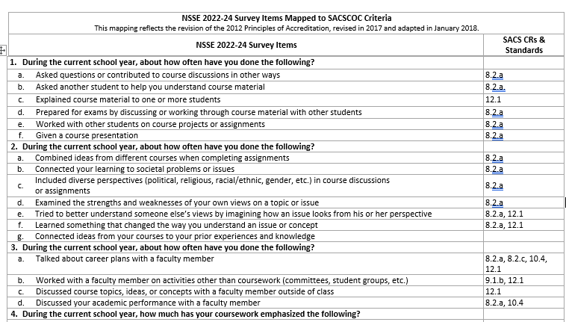
Supporting NSSE Use in Accreditation
NSSE Accreditation Toolkits
NSSE's Accreditation Toolkits include guidelines that suggest ways to map survey items to accreditation standards, timelines to help institutions decide when and how often to collect student engagement data, and examples of how other institutions in each region have used NSSE in their accreditation efforts.

Slide 58
Comments from NSSE Campus Project Managers about using data for improvement:
“Our Center for Teaching Excellence led workshops based on discipline area to lead faculty through an examination of their results and to facilitate discussion of how NSSE could be combined with other forms of institutional data to refine curriculum.”
“We use selected NSSE items and the Writing module for our SACSCOC Quality Enhancement Plan… and the diversity and inclusion module to assist us with a belonging initiative.”

Slide 59

Example of Data Use:
Increasing Academic Challenge
UNIVERSITY OF MARY WASHINGTON
Finding:
  First-year students perceived UMW
  contributes less in areas of writing
  and integration of ideas.
Action:
  Faculty authored SACS Quality
  Enhancement Plan (QEP) established
  uniform and measurable learning
  outcomes for all First-Year Seminars. Academic learning centers developed online learning modules for students in information literacy, writing proficiency, and oral communication.
Notes:
This slide presents an example of how a NSSE-participating institution is already using its NSSE, BCSSE, and or FSSE data.
NSSE recommends creating your own slides and action items for your college or university.

Slide 60
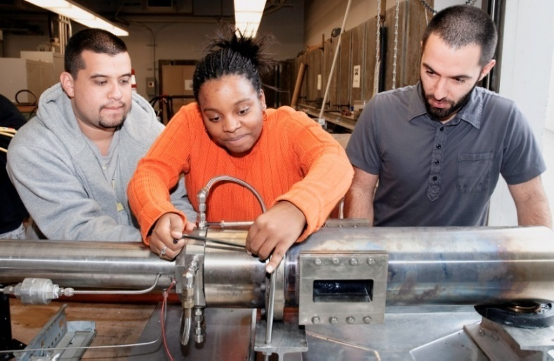
Example of Data Use:
Enriching the First-Year Experience
SOUTHERN CONNECTICUT STATE UNIVERSITY
Finding:
  Various data collected from BCSSE predicted graduation outcomes including difficulty with time management and talking with university staff about career plans.
Action:
  Created Academic Success Center and modified academic programs, policies, and instruction in order to advance student centeredness.
Notes:
This slide presents an example of how a NSSE-participating institution is already using its NSSE, BCSSE, and or FSSE data.
NSSE recommends creating your own slides and action items for your college or university.

Slide 61

Example of Data Use:
Enriching High-Impact Practices
CARLOW UNIVERSITY
Finding:
  High-impact practice participation rates were lower than peer institutions.
  Action: Five HIPs were added to or expanded within the core curriculum (writing intensive curriculum, capstone courses, service-learning, internships, and research with faculty).
Notes:
This slide presents an example of how a NSSE-participating institution is already using its NSSE, BCSSE, and or FSSE data.
NSSE recommends creating your own slides and action items for your college or university.

Slide 62

Example of Data Use:
Supportive Environment and Retention
CALIFORNIA STATE UNIVERSITY,
SAN BERNADINO
Finding:
  Campus living environment affects graduation and retention rates, as do student characteristics.
Action:
  NSSE data used to determine
  which campus housing practices
  have the most impact on student
  learning and success. NSSE also
  gives insight into populations of
  students who face unique
  challenges that other surveys
  may not capture.
Notes:
This slide presents an example of how a NSSE-participating institution is already using its NSSE, BCSSE, and or FSSE data.
NSSE recommends creating your own slides and action items for your college or university.

Slide 63

Example of Data Use:
Faculty and Staff Development
UNIVERSITY of SAN DIEGO
Finding:
  Greater emphasis needed on information literacy in the core curriculum.
  Action:
  Faculty, staff, and librarians developed new resources and curricular offerings to address these skills in students’ first year.
Notes:
This slide presents an example of how a NSSE-participating institution is already using its NSSE, BCSSE, and or FSSE data.
NSSE recommends creating your own slides and action items for your college or university.

Slide 64
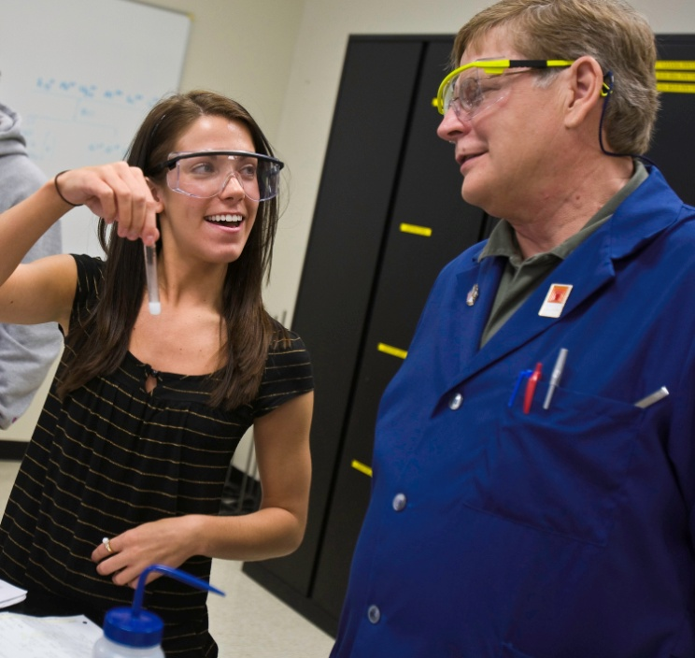
Example of Data Use:
Foster Collaboration and Focus
BIOLA UNIVERSITY
Finding:
  Early results showed lower NSSE scores on an Engagement Indicator than desired.
Action:
  Additional analyses were conducted, and results were disaggregated by student characteristics. Faculty offered additional training on classroom practices.
Notes:
This slide presents an example of how a NSSE-participating institution is already using its NSSE, BCSSE, and or FSSE data.
NSSE recommends creating your own slides and action items for your college or university.

Slide 65

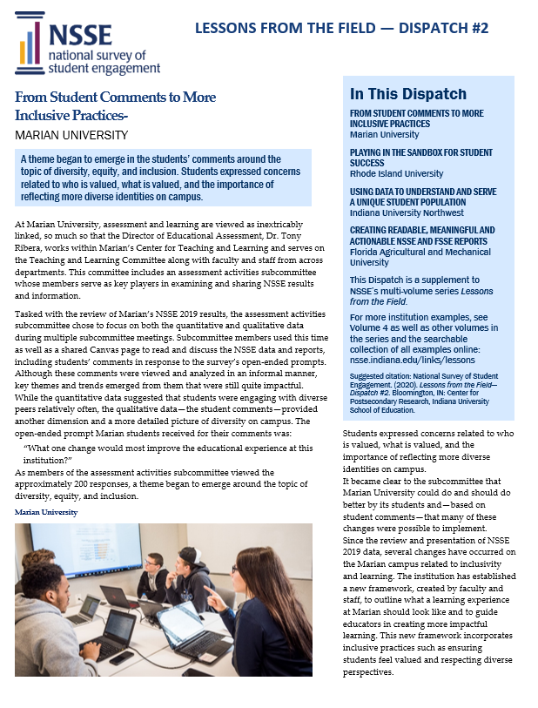

Additional Data Use Examples and Resources
Lessons from the Field is instructive as institutions seek to move from data to action
Searchable database for examples of NSSE, FSSE, and BCSSE use
Making NSSE Results Public
Guidelines for Display
of NSSE Results
View Institutional Data Use Examples At This Link

Slide 66

Recommendations for Using NSSE Results
1. Form a NSSE committee, team, or task force to provide representation & leadership
2. Disseminate NSSE results widely throughout the campus to stimulate interest and inspire action
3. Share NSSE results at the department level to increase involvement of faculty
4. Link NSSE data to other data sources to validate findings
5. Post NSSE results on your institutional website to enhance communication & promote transparency
Notes:
This slide presents an example of how a NSSE-participating institution is already using its NSSE, BCSSE, and or FSSE data.
NSSE recommends creating your own slides and action items for your college or university.

Slide 67

Questions & Discussion

Slide 68
Contact Information
[Institution]
NSSE Contact:
[Contact name]
[Contact email address]
Center for Postsecondary Research
Indiana University School of Education
201 North Rose Avenue
Bloomington, IN 47405-1006
Phone: 812-856-5824
Fax: 812-856-5150
Email: nsse@indiana.edu
Web: nsse.indiana.edu
Twitter: @NSSEsurvey, @NSSEinstitute
Blog: NSSEsightings.Indiana.edu
.
Notes:
If you have additional questions, feel free to contact the NSSE main office at 812-856-5824.
The NSSE Web site has updated information on NSSE project initiatives, background information, research, news articles, and more. On the website, you can find:
Complete list of all participating colleges and universities for NSSE 2000 through NSSE 2021
NSSE origins, conceptual framework, and psychometrics information
Electronic copies of NSSE national reports
Articles in national publications and colleges/university newspapers about NSSE
Research articles on web and paper mode, the disengaged commuter student, using focus groups to establish validity and reliability, and more
List of recent and upcoming NSSE conference presentations
NSSE electronic newsletter (NSSE e-News) with updates, tips and current events
Registration information for NSSE, BCSSE, or FSSE

Slide 69
Photo Credits
Thank you to the NSSE participating schools for allowing the use of institutional photos in the development of this PowerPoint template. The majority of the images in this show originate from Adobe Stock. We encourage you to insert your own campus photos for use in presentations.
.

